Slide 1
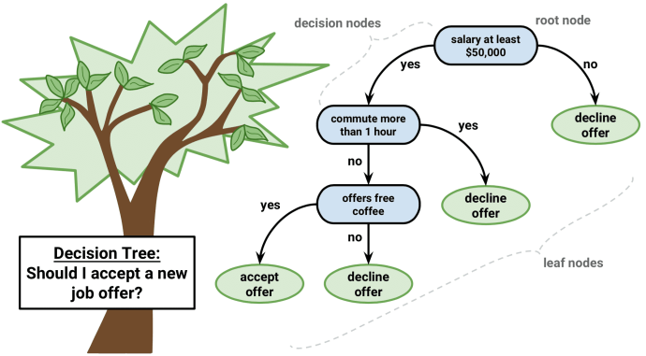
Decision Tree

Slide 2
Decision Tree Algorithm Pseudocode
Place the best attribute of our dataset at the root of the tree.
Split the training set into subsets. Subsets should be made in such a way that each subset contains data with the same value for an attribute.
Repeat step 1 and step 2 on each subset until you find leaf nodes in all the branches of the tree.

Slide 3
DIfferent classifier & their properties:
K-NN:
Naive Bayes:
Logistic regression:
Linear regression:
SVM:

Slide 4
Decision Tree: nested if-else classifier
Decision tree is simply a if-else condition classifier (programmatically interpretation.

Slide 5
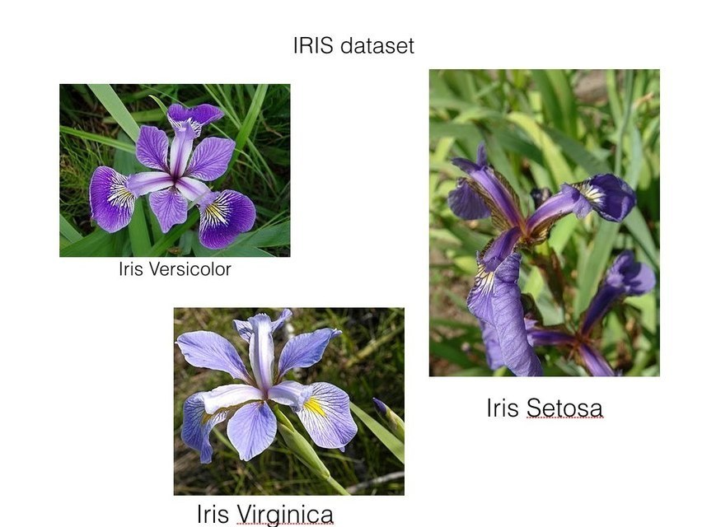
IRIS Dataset: y = (setosa, versicolor, virginica)

Slide 6
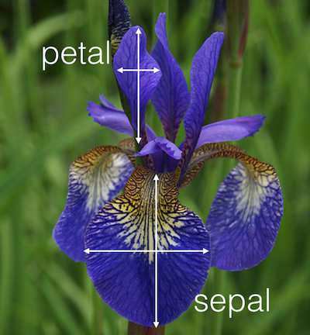
measurement:
Petal and Sepal
Length
Width

Slide 7
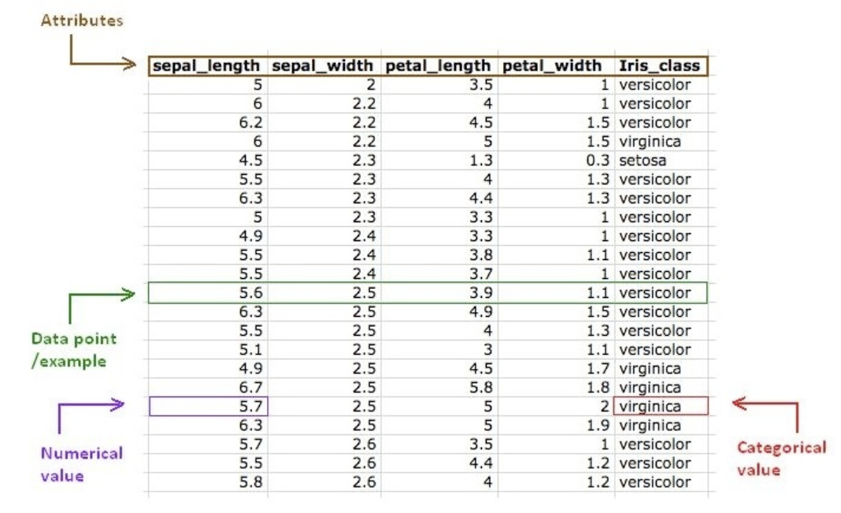
IRIS: sample dataset
Features (x) =
sepal_length, sepal_width, petal_length, petal_width.
Labels (y) =
Iris_class or flower species.

Slide 8
For example: Let’s build a if-else model.
Xi = <SL, SW, PL, PW>
Yi = <sentosa, versicolor, virginica>

Slide 9
Decision tree starts with a node with conditions and divided into several nodes, this diagram is called a tree.
For example: Let’s build a Decision tree model (graphically)

Slide 10
Broadly we have four nodes in DT:
root-node: This is the starting node.
leaf-node: These are branches of the root node.
internal-node: These are neither leaf nodes or root nodes.
non-leaf node: These are nodes that make decisions, these are called the nodes of decision tree.

Slide 11
Geometric intuition: In decision tree all of the hyper-planes are axis parallel [ A set of axis parallel hyperplanes that divide the entire region into hypercubes & hypercuboids ]

Slide 12
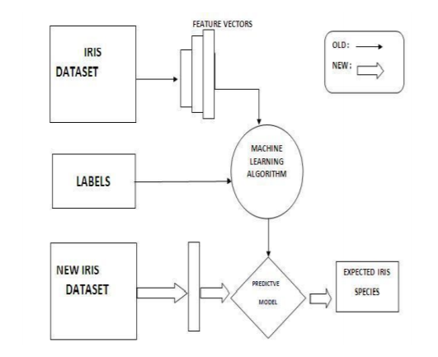
workflow diagram for modeling

Slide 13
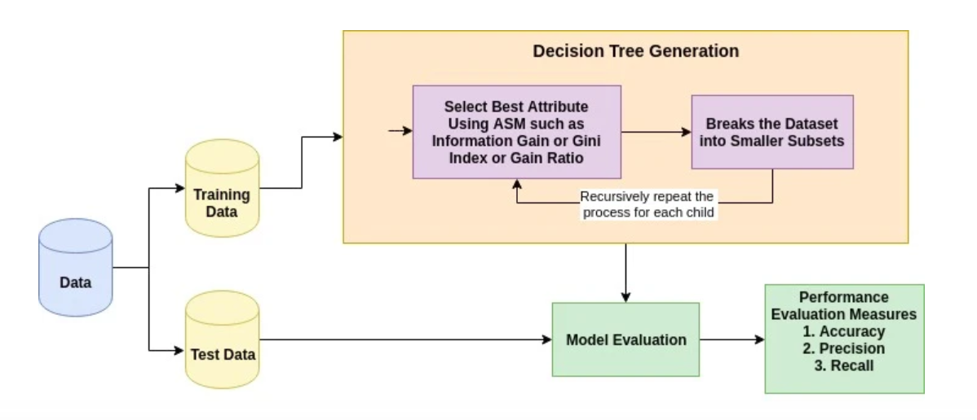
Decision tree: Generation

Slide 14
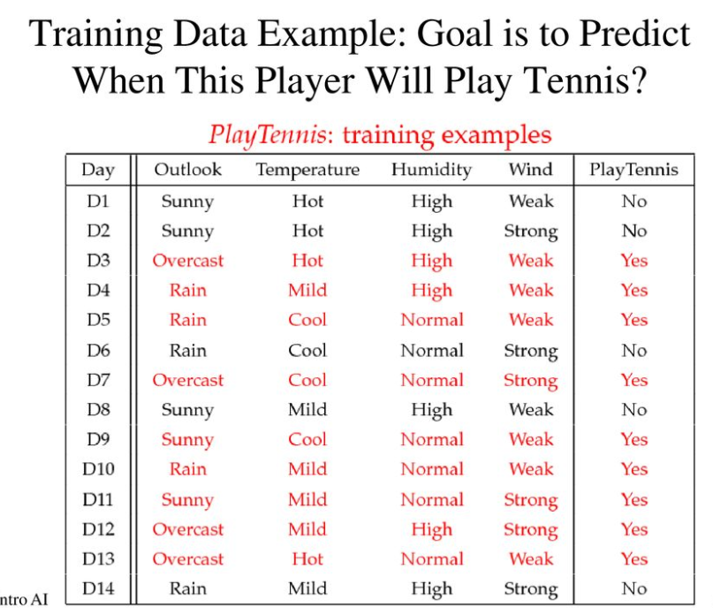
weather dataset: to predict play or not
Famous dataset in the machine learning world: weather dataset
(playing game Y or N based on weather condition).

Slide 15
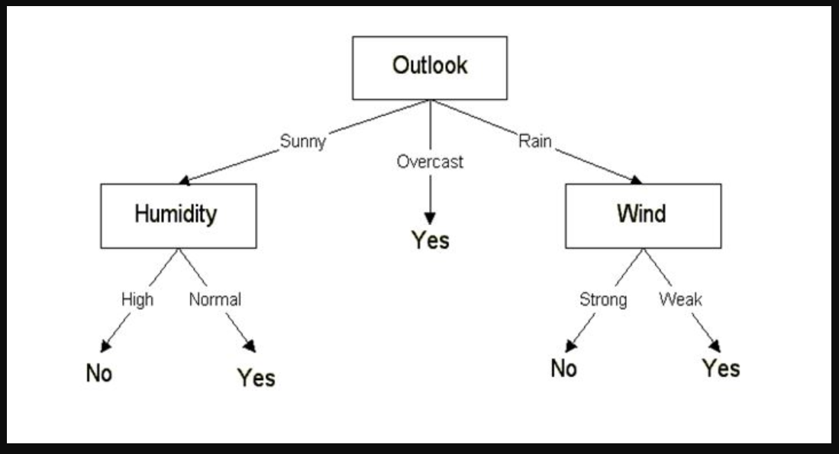
Tree diagram: weather dataset
Once we have a DT (or model) we can use it to make predictions on observations that are not in the original training table, consider:
Outlook = Sunny, Temperature = Mild, Humidity = Normal, Windy = False, Playtennis = ?

Slide 16
Construct decision tree:

Slide 17


Entropy: equation
Formula:

Slide 18
Entropy: properties [ for two-class classifier ]

Slide 19
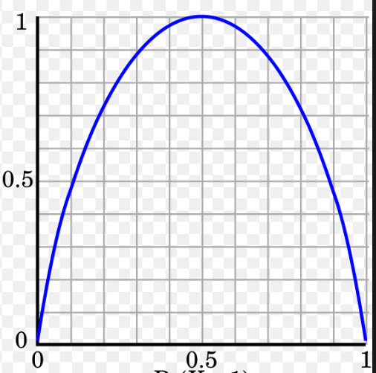
Entropy curve:
Entropy curve is symmetric in nature

Slide 20
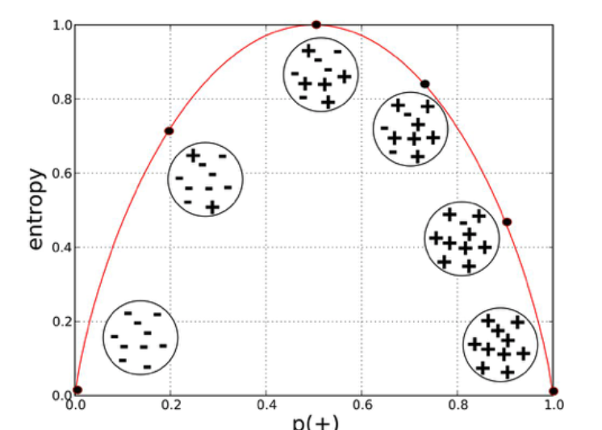
Entropy curve: data distribution
Observation: Entropy is at its maximum if we have a 50%-50% split among the positive and negative examples.
Observation: Entropy is zero if we have all positive or all negative examples.

Slide 21
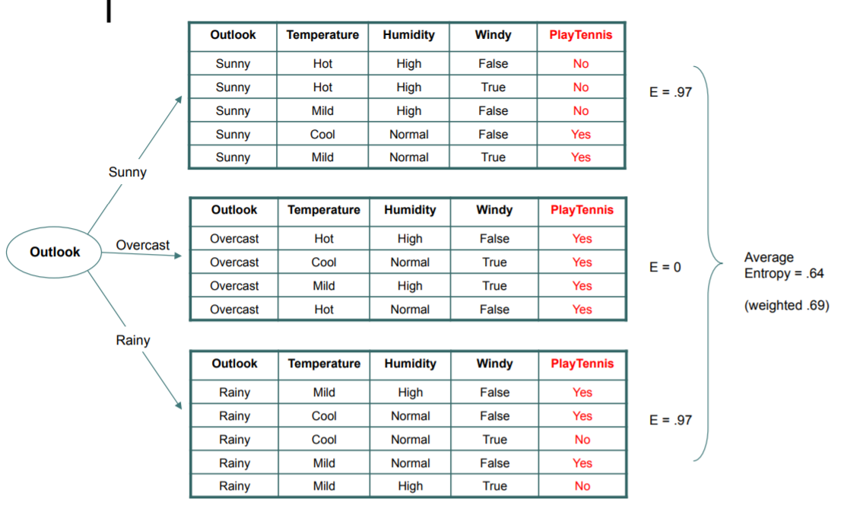
Information gain: partitioning the dataset

Slide 22
Information gain: equation
Formula:

Slide 23
Gini impurity: ~ similar to entropy
Formula:

Slide 24
Gini impurity: properties [ for two-class classifier ]

Slide 25
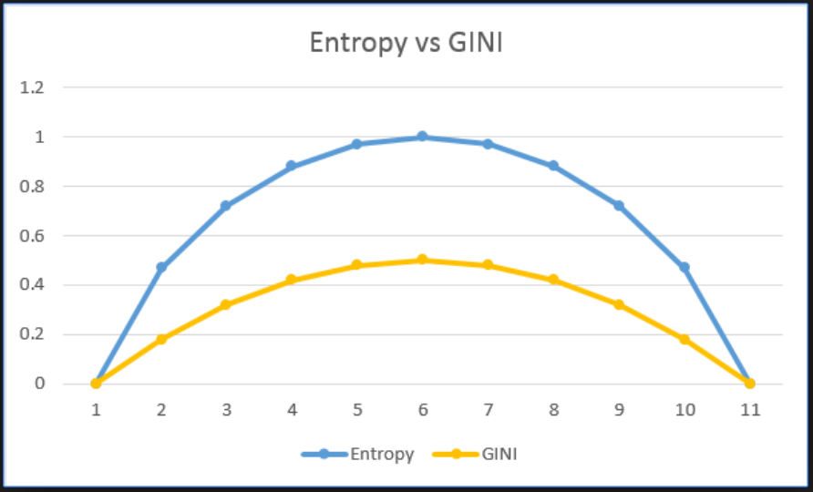
entropy vs gini impurity:
Calculation of information gain is computationally more expensive than entropy, In real world people will take gini - impurity as the measure.

